Slide 1


Fundamentals of RM
RM System and Process
Leadership in RM
Incident Investigation
RM Tools & Challenges
RM in Industry
People & Org.
Application and Perspectives
On Becoming a
Leader in Risk Management
ENGG404 - Lecture
Your Quick-start Guide to ENGG404
Expectations, Course Syllabus, Course Plan, and Exam
Instructions to Lecturer:
Tee-up PPT if using it.
Tee-up Mentimeter.
Tee-up eClass.

Slide 2
Learning Outcomes:
At the end of this topic, you will be able to:
Explain how this course is different from a typical engineering course.
Explain the key points in the Course Syllabus.
Marking Scheme and Deductions
Final Letter Grade
Course Level Learning Outcomes
Navigate on eClass for this course
Access and explain the Course Plan and the deadlines.
Access the ENGG404 Student Resources shared drive.
Explain how PPT topics are presented.
Practice using Mentimeter.
ENGG404 Expectations, Course Syllabus, Course Plan, and Exam
2
Notes:
2

Slide 3
ENGG404 Course One-page Overview
Fundamentals
What is ESRM? Why Are They Important?, The Engineer’s Survival Guide, Hazard Identification, The Incident Pyramid, The Discovery Approach, Occupational Safety and Process (Technical) Safety, Risk as a Function of Likelihood and Consequence, Metrics, Health and Hygiene
Occupational Health and Safety in Canada and Alberta, WCB in Alberta, Due Diligence for Engineers, Professionalism and Ethics
Leadership in RM
RM Tools
Incident Investigation
RM Program Elements
RM System Elements, Administrative Controls and Work Practices, Engineering Controls, The Business Case for a RM Program
Why is II important?, PEAP, Cause and Effect Model, Root Cause Analysis, Incident and Near Miss Reporting, Follow Up, Student Team Project & Report
How Do We Manage Risk?, The RM Work Process, Substandard Practices and Conditions, The Hierarchy of Controls, Risk Matrices, FLRAs, JSAs, SQRAs, Checklists, Bow Tie Analysis, Job Observations, Planned Inspections, Audits, Prevention Through Design, What If Analysis
Why is Leadership Important?, Safety Culture, Personal Iceberg, ABC, and Training Models, Plan-Do-Check-Act, Application of the ESG, Risk Communication
Industry & Gov’t Engagement
Guest Lectures from Magna IV Engineering, PCL Construction, AB Justice, WCB, Imperial Oil, BBA Engineering, Director of the School of ESRM
Legal & Ethical Aspects
Case Studies
Sunrise Propane, Hub Oil, Imperial Metals Mount Polley, MMA Lac Megantic, UCIL Bhopal, Nypro Works Flixborough, BP Macondo DWH, Boeing 737 Max 8, ALCOA
ENGG404 Expectations, Course Syllabus, Course Plan, and Exam

Slide 4
This Course is Different – Case Study and Blended Learning!
Key Differences!
Case Study Methodology
No complex formula - any calculations are basic arithmetic.
No absolute right or wrong answer.
Apply sound principles, practices, and rationale of engineering, and leadership in risk management to support your position
Lots of examples to work through in this course
Blended Learning Format:
Requires students to prepare ahead of lectures
Review lecture PPTs and/or textbook, review videos or readings
Respond to on-line eClass quizzes BEFORE the lectures
Designed to motivate the student to prepare ahead of lectures, NOT assess after lectures
Active Learning Exercises
In-class, designed to engage students and to self-assess (not graded)
ENGG404 Expectations, Course Syllabus, Course Plan, and Exam
4
Notes:
4

Slide 5
Course Syllabus:
Welcome to Leadership in Risk Management
“As future engineering and business leaders, you will be confronted with a myriad of risks …
Your job will be to manage those risks — all of them.
As you will see in this course, engineers are in the business of risk management. Our intent is to broaden your view and develop your leadership capability in risk management toward supporting your successful engineering career. Leading organizations in the field of risk management comment “As future engineering and business leaders, you will be confronted with a myriad of risk. Your job will be to manage those risks — all of them.”
ENGG404 Expectations, Course Syllabus, Course Plan, and Exam
5
Notes:
5

Slide 6
Course Syllabus:
Class and Instructor Information:
The School of Engineering Safety and Risk Management:
Professor Winkel,
P.Eng., M.Sc.Eng.;
Chair
Professor Coles,
P.Eng., M.Eng.;
Director, Industrial Professor
Professor Cocchio,
P. Eng., MBA;
Industrial Professor
Dr. Lefsrud,
PhD, P.Eng.;
Assistant Professor
Dr. Macciotta,
PhD, P.Eng.;
Industrial Professor
Dr. White,
PhD, P.Eng.;
Industrial Professor
ENGG404 Expectations, Course Syllabus, Course Plan, and Exam
6
Notes:
6

Slide 7

Course Syllabus:
Course Information:
Most questions pertain to:
Marks and Deductions
Course Plan
eClass
Final Exam
Seminars
Answers:
All in the Syllabus
Highlights presented here …
ENGG404 Expectations, Course Syllabus, Course Plan, and Exam
7
Notes:
7

Slide 8
Course Syllabus:
When to Take This Course (complete details in the Syllabus):
Are you taking ENGG404 out-of-sequence (i.e. not taking this course per your program / plan / year schedule)?
Think again! Consider these points:
400-Level / 4th year heavily-weighted course: Weighting = 3.8
Team project with your cohort is beneficial; on a work-term is a hindrance!
In-sequence with Program/Plan and Year: Team Project Intent is to work on a team project with specific relevance to your engineering discipline to enhance your learning experience in this course.
On a work term? This course uses blended learning techniques and requires attendance, participation, and engagement in real-time. Your work-term commitments will create conflicts and are barriers to success.
You should NOT take this course out-of-sequence, or as an “add-on” while on your work term.
ENGG404 Expectations, Course Syllabus, Course Plan, and Exam
8
Notes:
8

Slide 9
Course Syllabus:
Marking Scheme – the Allocation of Course Marks:
Deductions – may apply on late or missed submissions (assignments, quizzes, ITP Surveys), missed seminars, lack of participation / contribution on the Team Project.
Activity | (A)Synchronous | Weight
On-line Quizzes | Asynchronous | 5%
Assignment #1 | Asynchronous | 2%
Assignment #2 | Asynchronous | 2%
Assignment #3 | Asynchronous | 5%
Assignment #4 | Asynchronous | 5%
ITP Metrics Surveys, (1st = 2%, 2nd = 1%) | Asynchronous | 3%
Team Project - Preliminary RCA Chart Review | Synchronous | 3%
Team Project - Progress Report | Asynchronous | 5%
Team Project - Final Report | Asynchronous | 15%
Course Term Work Total |  | 45%
Final Exam | Synchronous | 55%
Deductions (see section below): |  | variable
Total Course Mark (less any applicable deductions): |  | 100%
ENGG404 Expectations, Course Syllabus, Course Plan, and Exam
9
Notes:
9

Slide 10
Course Syllabus:
Final Grade:
Based on results and grade distributions in previous years:
The Letter Grade of A or higher will be submitted for those achieving a total course mark of 90% or higher; that is, based on distributions, the cut-off mark to get an A may be 90% or it may be lower than 90%, but it will not be higher.
The Letter Grade of D or higher will be submitted for those achieving a total course mark of higher than 60%. The Letter Grade of F may be assessed for a total course mark of 60% or lower.
Minimum marks required for other letter grades vary from year to year and cannot be predicted ahead of time.
ENGG404 Expectations, Course Syllabus, Course Plan, and Exam
10
Notes:
10

Slide 11
Course Syllabus:
Textbook:
“A Handbook for Becoming a Leader in Risk Management”.
Available as a PDF on eClass – no cost to you!
Supplements learning … goes hand-in-glove / provides the basis for in-class active learning exercises that facilitate your learning.
Will be a great resource in your future roles in your career.
Seminar Periods – Team Project:
The Team Project is a major course component and is an opportunity for you to work in Teams, a very common and leading practice in industry, and one in which you can develop your leadership skills.
Starting in Week 4, seminars are used for team project instruction
  Dates are posted on the Course Plan
  Work on your Team Project; thus, you MUST attend the seminar in which you are registered
  Seminars are mandatory attendance as stated in the Course Plan.
ENGG404 Expectations, Course Syllabus, Course Plan, and Exam
11
Notes:
11

Slide 12
Course Syllabus:
University Policies:
Academic Integrity: The University of Alberta is committed to the highest standards of academic integrity and honesty. Students are expected to be familiar with these standards regarding academic honesty and to uphold the policies of the University in this respect.
The Code of Student Behaviour:
https://www.ualberta.ca/governance/resources/policies-standards-and-codes-of-conduct/code-of-student-behaviour
Avoid any behaviour which could potentially result in suspicions of cheating, plagiarism, misrepresentation of facts and/or participation in an offence.
Academic dishonesty is a serious offence and can result in suspension or expulsion from the University.
ENGG404 Expectations, Course Syllabus, Course Plan, and Exam
12
Notes:
12

Slide 13
Course Syllabus:
Course-level Learning Outcomes – Eight of them:
At the end of this course, the student should be able to:
Appraise the safety culture …
Assess and positively influence the safety leadership …
Apply leadership tools and programs …
Apply a set of incident investigation and root cause analysis tools …
Collaborate on a team …
Integrate and apply lessons learned from others …
Explain relevant portions from various acts, regulations, codes, etc.
Recognize and examine a situation where professional conduct and ethics may be called into question …
ENGG404 Expectations, Course Syllabus, Course Plan, and Exam
13
Notes:
13

Slide 14
Course Syllabus:
Expectations for the Exam:
Information (date, time, parameters) will be widely communicated in advance of the Final Exam.
The intent of the Final Exam Expectations is to help you prepare to successfully write your final exam.
The final exam will be administered through eClass, at the fixed day and time as set by the University. More details will be communicated.
You are expected to abide by the University Academic Integrity Policies and maintain academic integrity and honesty within these boundaries. It is expected that you complete this Final Exam by yourself, and that you do so without any input, assistance, or support from any other individual. Components of your efforts on this final assignment can be compared to others, and any findings where there is "duplicate work" may indicate plagiarism and a breach of academic integrity i.e. cheating. If substantiated, this can result in academic penalties.
ENGG404 Expectations, Course Syllabus, Course Plan, and Exam
14
Notes:
14

Slide 15
How to Succeed in this Course & Prepare for the Final Exam:
Q: Two questions that are often asked are,
“How do I succeed in this course?
"What and how do I study for the final exam for this course?"
A: The brief answer:
Review concepts, principles, and practices AND apply them:
Prepare for each lecture ahead of time, regularly attend lectures, and regularly review what you have learned.
Assess yourself on the “Learning Outcomes”:
Each lecture Topic PPT starts with a slide that lists the "Learning Outcomes" and ends with a slide (or two) that lists the "Summary and Key Lessons".
Review the content on these lists to determine your level of skill and confidence in explaining / applying those learning outcomes and the summary and key points, and as a guide to direct your preparation efforts.
ENGG404 Expectations, Course Syllabus, Course Plan, and Exam
15
Notes:
15

Slide 16
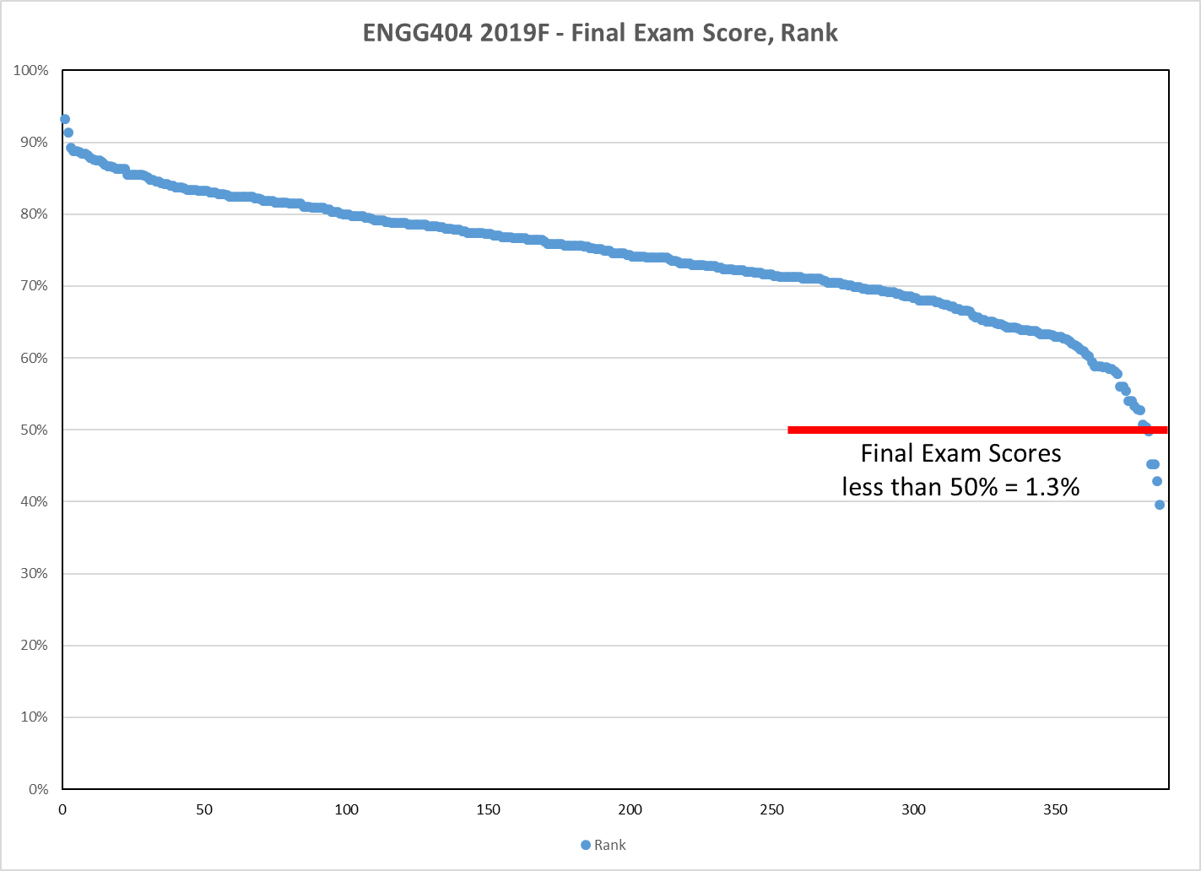
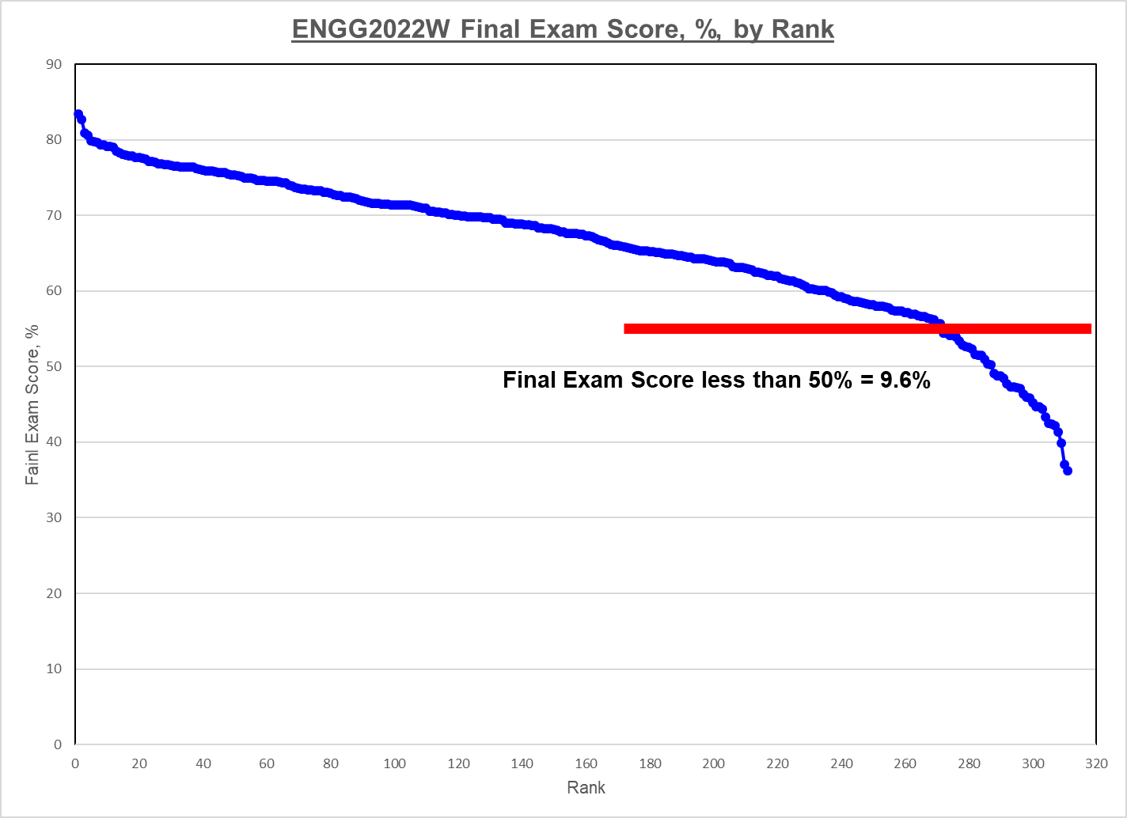
Final Exam – “All Available Material Resources”:
Please note that the Final Exam is challenging!
You may have heard that the Final Exam is “open book”. It has been for several terms now, but we have not yet decided for the 2022S term.
But let’s suppose that you will be able to access any and all available material resources, this is NOT an effective substitute for preparing for and studying for the final exam.
It is HIGHLY recommended that you prepare for this Final Exam as though it were proctored and WITHOUT access to any materials.
Final Exam Comparison, essentially the same exam:
2019F at <50% = 1.3% 2022W at <50% = 9.6%
(no access to resources) (access any available resources)
Same for all subsequent terms: 2020F, 2021W, 2021S, 2021F, 2022W: ~10%
ENGG404 Expectations, Course Syllabus, Course Plan, and Exam
16
Notes:
16

Slide 17
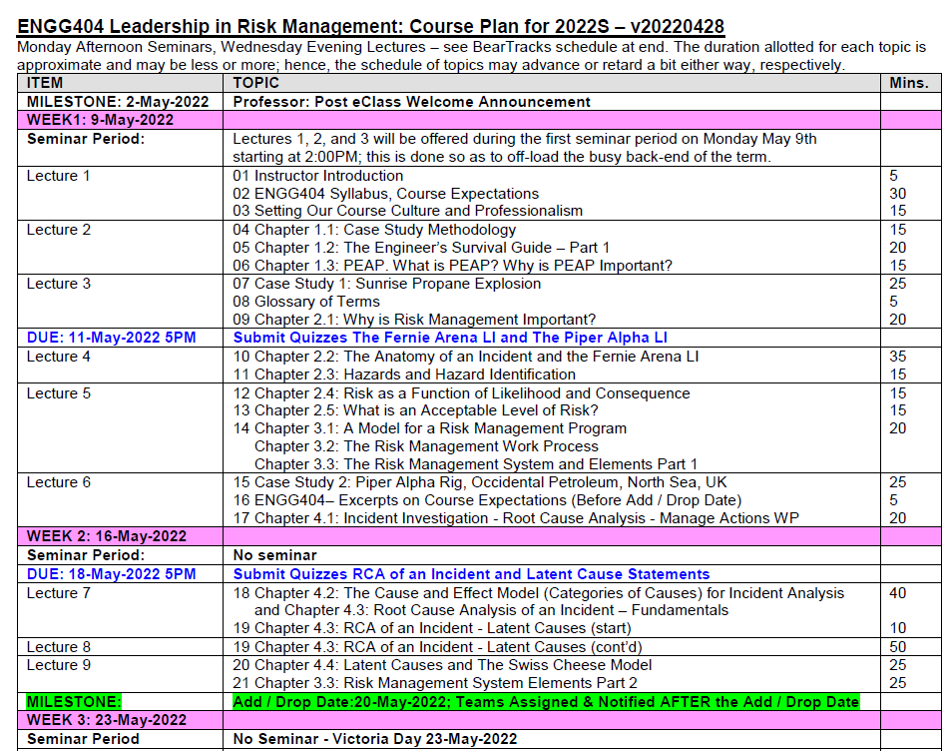
ENGG404 Course Plan – posted on eClass:
The Course Plan lists the order of topics, and ALL DUE DATES!
Use it to plan your studies in order to prepare for the lectures!
ENGG404 Expectations, Course Syllabus, Course Plan, and Exam
17
Notes:
17

Slide 18
eClass Overview:
Overview of eClass, How Work is Submitted, Exams at LAC:
Overview of eClass
  Syllabus, Course Plan, Textbook, etc. are posted on eClass
  All assignments are posted on eClass
  All work is submitted on eClass
  Open eClass:
ENGG404 Expectations, Course Syllabus, Course Plan, and Exam
18
Notes:
18

Slide 19
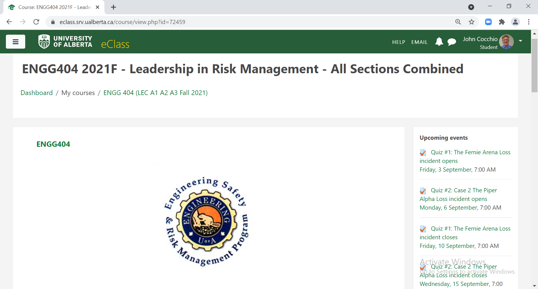
eClass Overview:
Upcoming Events – due dates for Assignments, Quizzes, Team Project Components, and the Final Exam:
All due dates for assignments and on-line eClass quizzes (except ITP Survey) are listed under “Upcoming Events”.
ENGG404 Expectations, Course Syllabus, Course Plan, and Exam
19
Notes:
19

Slide 20
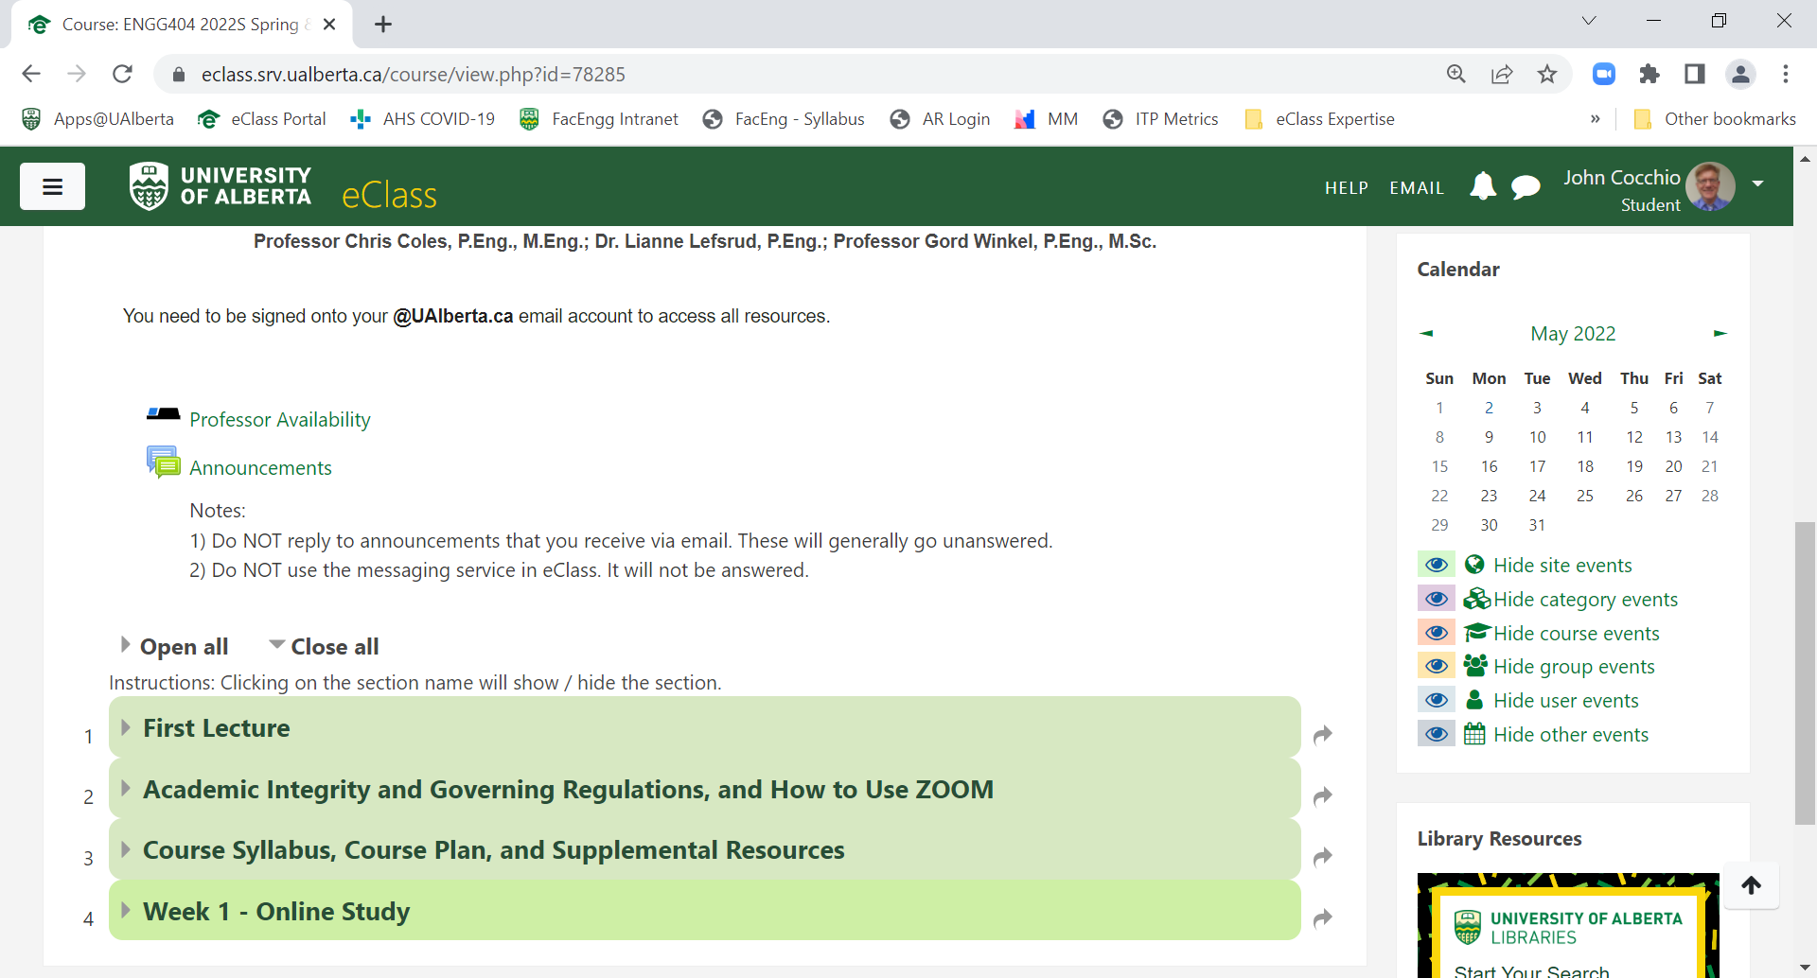
eClass Overview:
Zoom meetings – different links for different Professors.
Announcements, Professor Availability, eClass Sections
Announcements
Professor Availability
Academic Integrity
Course Syllabus
Course Plan
ENGG404 Expectations, Course Syllabus, Course Plan, and Exam
20
Notes:
20

Slide 21
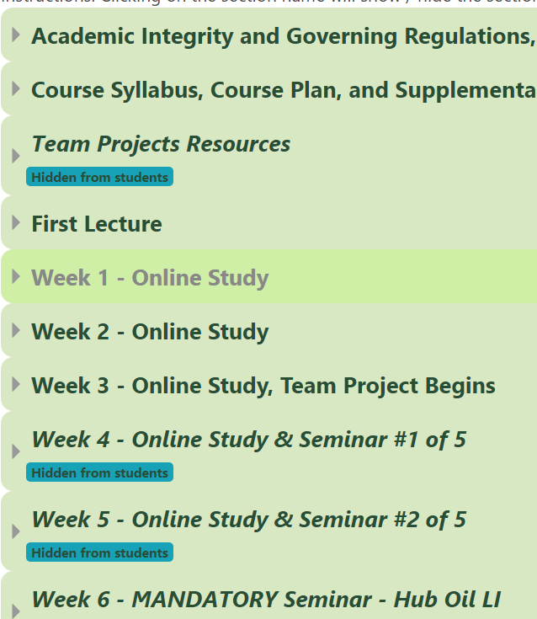
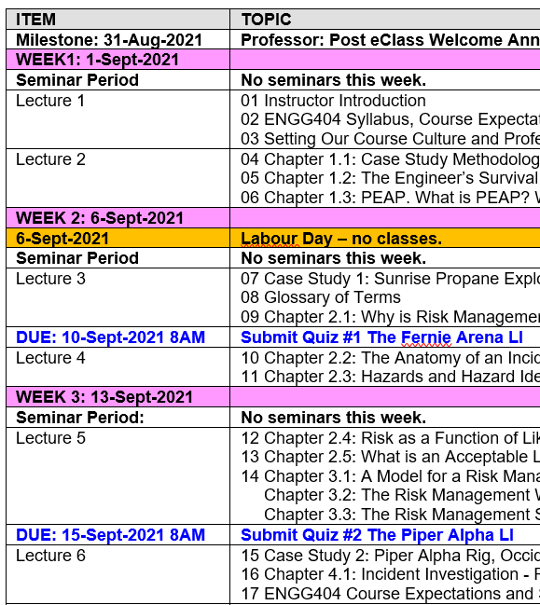
ENGG404 Course Plan Matches eClass:
The “Week #” tabs on eClass match the Course Plan
ENGG404 Expectations, Course Syllabus, Course Plan, and Exam
21
Notes:
21

Slide 22
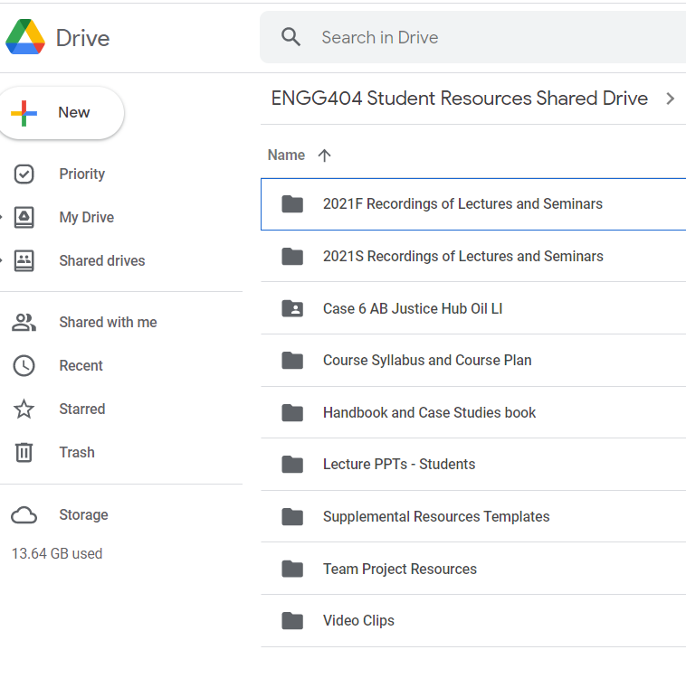

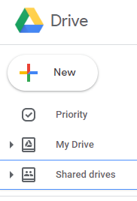
ENGG404 Student Resources:
Go to your email APPS icon
Select Drive
Under Drive, select Shared Drives, then select
ENGG404 Student Resources
ENGG404 Expectations, Course Syllabus, Course Plan, and Exam
22
Notes:
22

Slide 23
How PPT Topics are Presented:
Not all slides in a PPT have equal time weighting!
The lecturer will spend more time on key slides and may touch on other slides.
Attendance at lectures and seminars will be necessary to discern the difference.
ENGG404 Expectations, Course Syllabus, Course Plan, and Exam
23
Notes:
23

Slide 24

Mentimeter Ground Rules:
Before you Menti!
Honest? Sincere?
Constructive? On topic?
Thoughtful? Intellectual?
Meaningful? To the point?
Considerate? Polite? Respectful?
ENGG404 Expectations, Course Syllabus, Course Plan, and Exam
24
Notes:
24

Slide 25
In-Class ALE: Practice on Mentimeter:
Use this to practice access to Mentimeter:
What is your favourite colour? (MM-Open)
What is your favourite colour? (MM-Poll)
What is your favourite colour? (MM-Scales)
ENGG404 Expectations, Course Syllabus, Course Plan, and Exam
25
Notes:
25

Slide 26
Your Next Steps:
Review the Course Syllabus.
Navigate to eClass for this course and explore.
Check the Course Plan and enter important deadlines into your Calendar.
Navigate to ENGG404 Student Resources shared drive and explore.
ENGG404 Expectations, Course Syllabus, Course Plan, and Exam
26
Notes:
26

Slide 27
In-Class ALE: Questions about the Course?
Do you have any questions …syllabus, course, team project, assignments, final exam? (MM – Open)
ENGG404 Expectations, Course Syllabus, Course Plan, and Exam
27
Notes:
27

